Slide 1
LaGuardia CC: Faculty Needs Assessment Survey
Fall 2019
LaGuardia Community College (CUNY)
Center for Teaching & Learning
31-10 Thomson Ave, M-414
718.482.5462

Slide 2
Survey Participants
191 | 147 (77.0%) | 37 (19.4%) | 7 (3.7%)
Total | Full-time faculty | Adjunct faculty member employed as staff | Adjunct faculty employed outside of LaGuardia

Slide 3
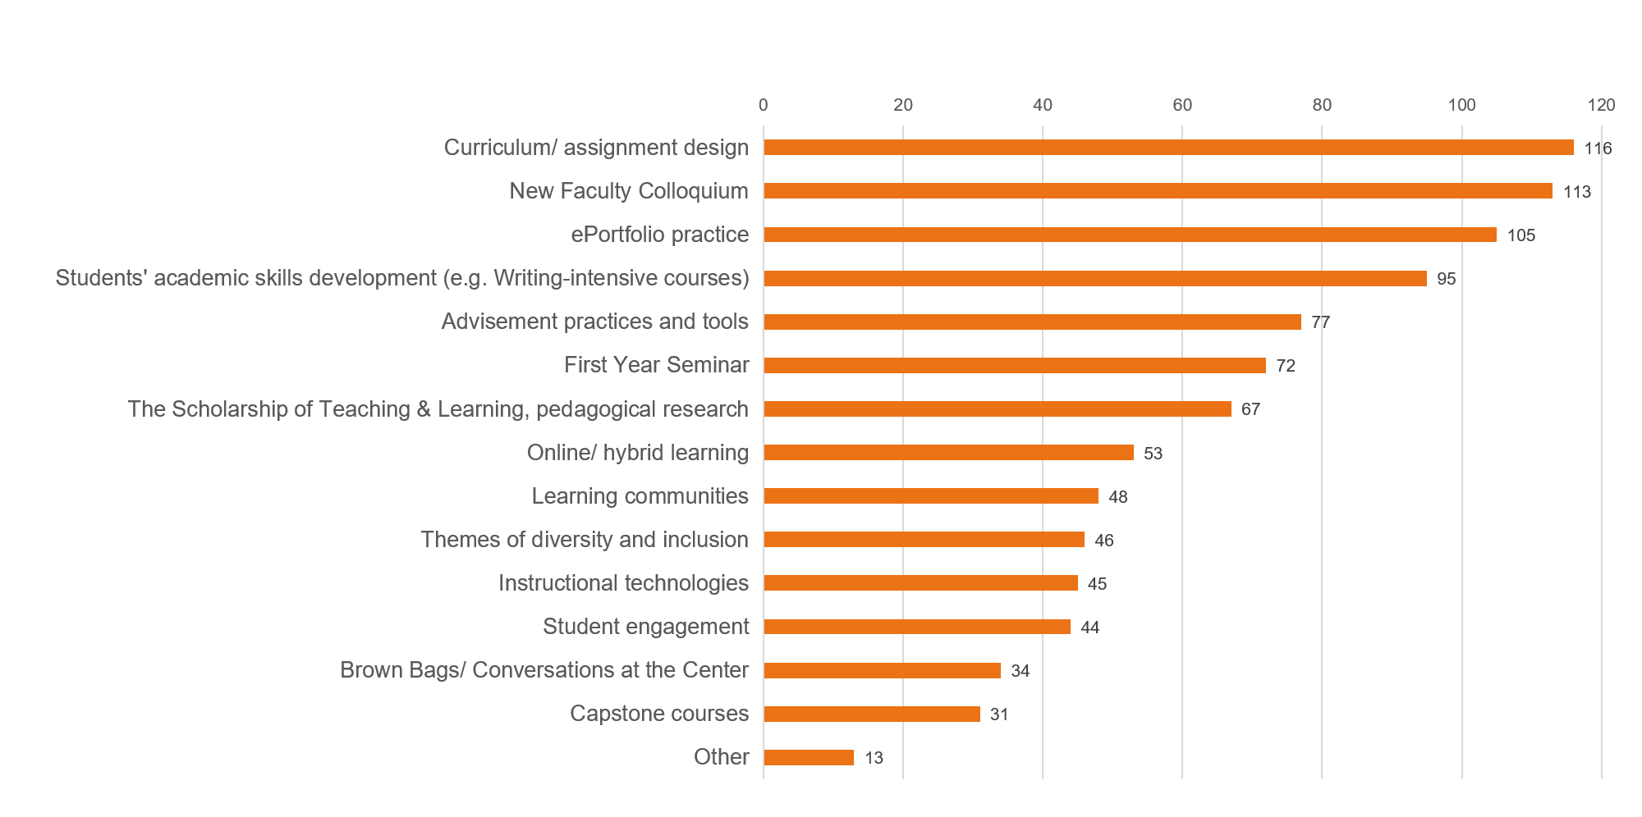
CTL Engagement: Activities

Slide 4
Implemented/Applied learning into classroom:
Yes
No
Other
10 total
3 F/T faculty
9 total
7 F/T faculty
169 total
134 F/T faculty

Slide 5
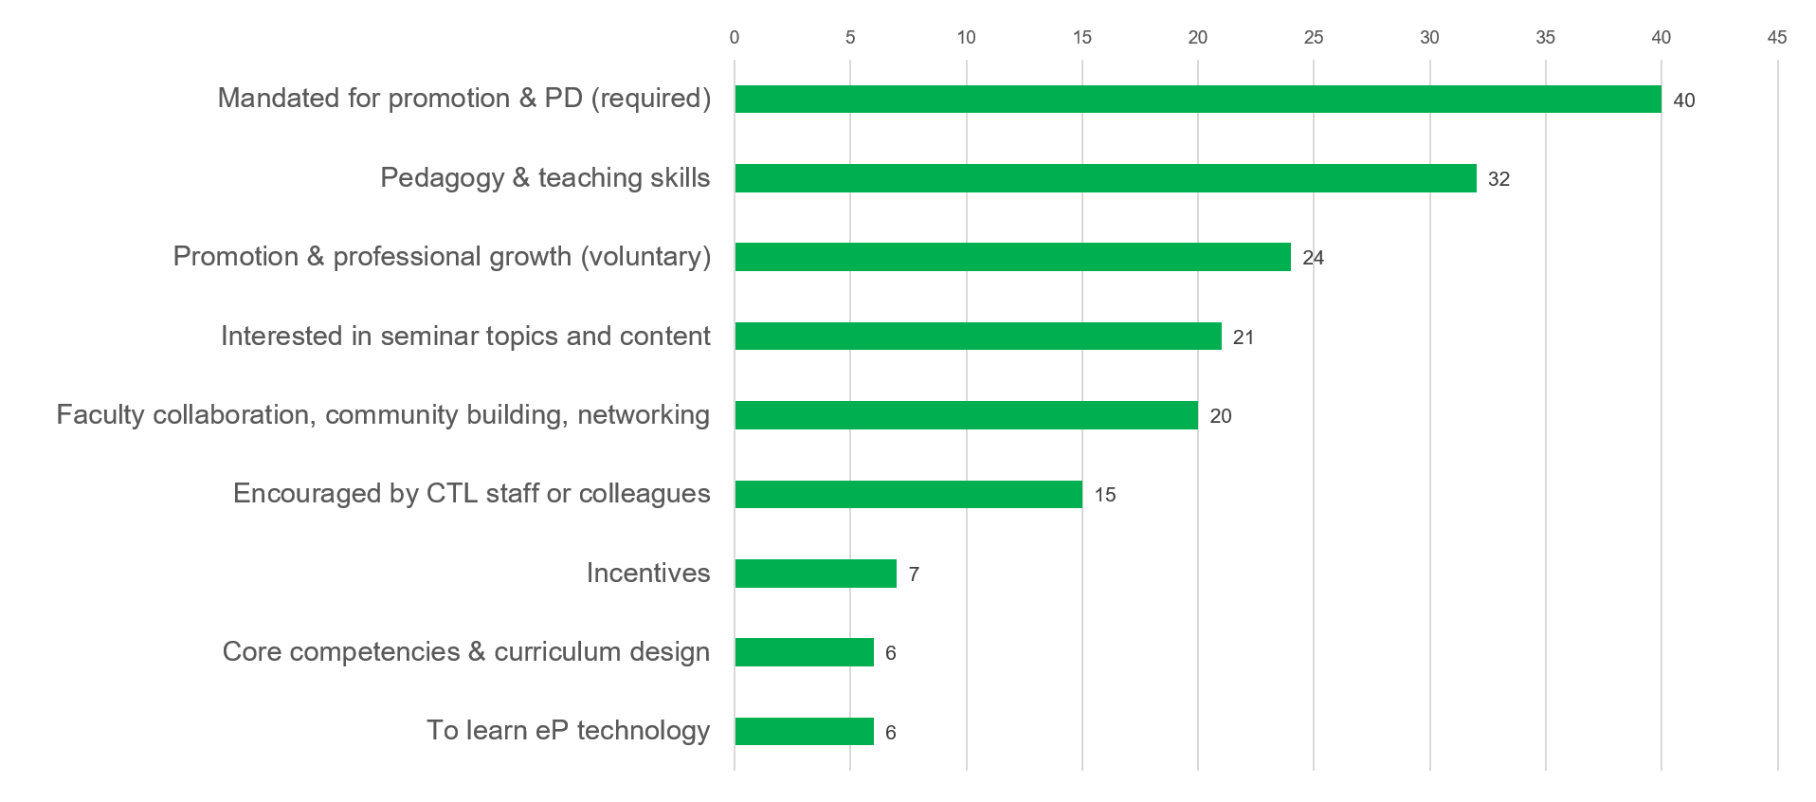
CTL Engagement: Motivation

Slide 6
PD Seminar/Workshop Format
Intensive seminars: more than a year, may include summer
Year-long seminars (~25 hours/year)
One-semester or “mini” seminars (10-15 hours/semester)
Mini-grants (Assignment Design, ePortfolio)
Conferences (Humanities, First Year, etc.)
Brown-Bags/Conversations at the Center and/or short workshops
In Transit author (manuscript or chapter)
In Transit author (short pieces, book reviews, etc.)
Benchmark Readings (norming sessions, scoring, reflection)
Evening/weekend workshops
Online (asynchronous) workshops
Intensive seminars: more than a year, may include summer
Year-long seminars (~25 hours/year)
One-semester or “mini” seminars (10-15 hours/semester)
Mini-grants (Assignment Design, ePortfolio)
Conferences (Humanities, First Year, etc.)
Brown-Bags/Conversations at the Center and/or short workshops
In Transit author (manuscript or chapter)
In Transit author (short pieces, book reviews, etc.)
Benchmark Readings (norming sessions, scoring, reflection)
Evening/weekend workshops
Online (asynchronous) workshops
102
140
140
123
91
85
70
59
138
64
75

Slide 7
Participation has contributed to:
Teaching/ Pedagogy
College or departmental contribution
Scholarship
Leadership
48 total
44 F/T faculty
65 total
59 F/T faculty
109 total
103 F/T faculty
140 total
111 F/T faculty

Slide 8
Impact of Co-leading a Seminar
Enhanced my relationships with colleagues
Broadened my capacity to collaborate
Advanced my knowledge of offices/ services at the College
92.2%
81.3%
81.0 %
Categories | *Significant or noticeable Impact |  | Some Impact or Little to No Impact
 | Count | % | Count | %
Enhanced my relationships with colleagues | 59 | 92.2 % | 5 | 7.8 %
Broadened my capacity to collaborate | 52 | 81.3 % | 12 | 18.8 %
Advanced my knowledge of offices/services at College | 51 | 81.0 % | 12 | 19.0 %
Improved my communication skills | 34 | 53.1 % | 30 | 46.9 %
Strengthened my organizational skills | 31 | 48.4 % | 33 | 51.6 %

Slide 9
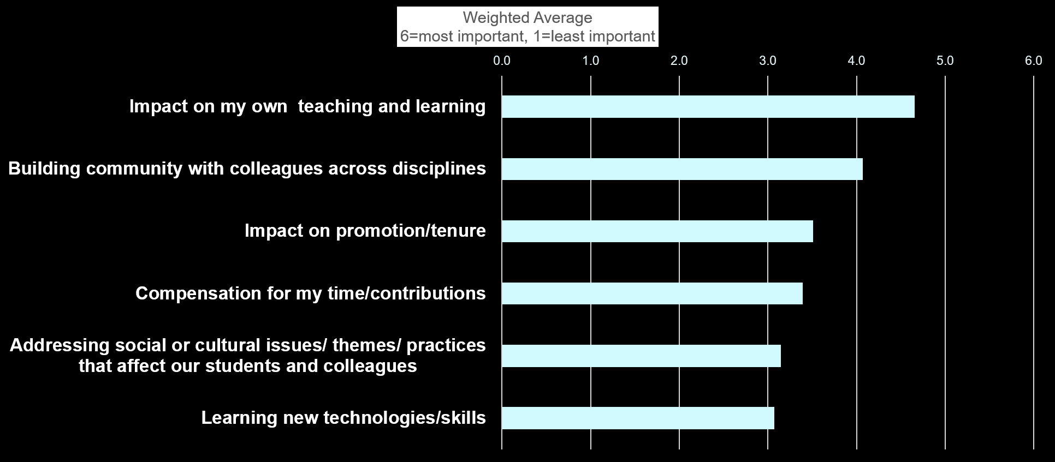
Ranking the importance to your participation

Slide 10
Suggested Engagement Opportunities
99 Responses: 114 Suggestions
# Mentions | Suggestions
16 | Pedagogical Approaches: student agency, critical literacy, co-curricular & experiential learning
12 | Diverse PD formats: online/hybrid, brown bags, panels
10 | Nuts & Bolts of Teaching: giving feedback, assessing learning, engaging in reading, language supports, motivating students
9 | Community Building: faculty mentorship, sharing practices, retreats, culturally-diverse activities for faculty
8 each | Inclusive Pedagogy | Discipline-based Pedagogy | Sustained Leadership Opps. College-wide Initiatives, i.e. Advisement, open ed resources (OER), FYS, Transfer

Slide 11
What’s Next?
New Activities & Opportunities | Process for Seminar Leadership | Collaboration & Coordination | 2017-18 CTL Evaluation
Proposal process for CTL-supported activities | Work w. Dept. Chairpersons | Engage Senate & Faculty Council | Posted on the CTL Website

